Slide 1

Analysis of COVID-19 Spread & Data Modelling

Slide 2
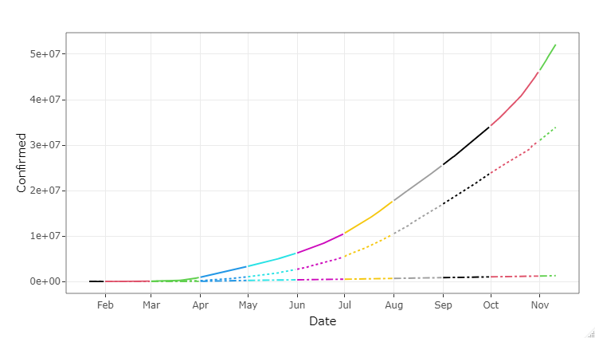
Disease Spread Timeline
Confirmed
WHO declared COVID – 19 as a Pandemic
Recovered
Deaths
Globally, as of 12th Nov 2020, there have been 51,547,733 confirmed cases of COVID-19, including 1,275,979 deaths, reported to WHO

Slide 3
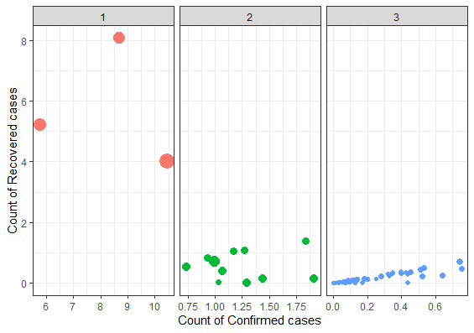
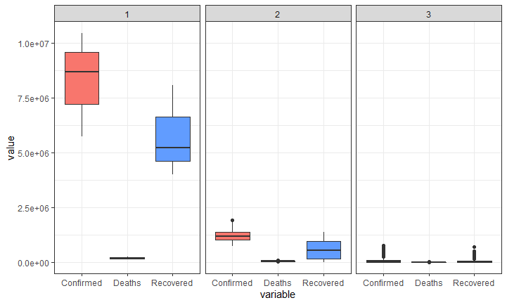
K-Means Clustering
High Risk
Medium Risk
Low Risk

Slide 4
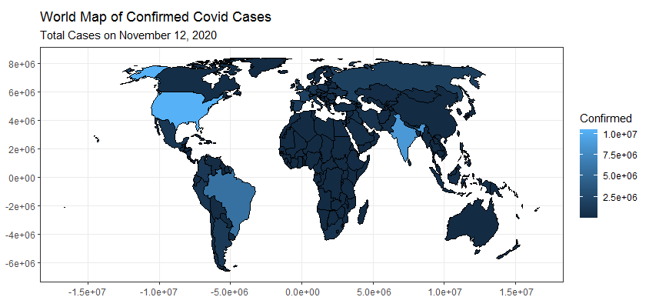
Global COVID-19 Confirmed Cases

Slide 5
TRAVEL ADVISORY
Attention all travellers
WHO continues to advise the travel restrictions to the countries like United States, India, and Brazil that are experiencing COVID-19 outbreaks.

Slide 6
3.9 BILLION PEOPLE
UNDER LOCKDOWN
ACROSS THE WORLD, 115 COUNTRIES HAVE ANNOUNCED EITHER A COMPLETE LOCKDOWN OR SHUTDOWN IN SOME TERRITORIES
Do lockdowns actually work?
The impact of Lock Down on Reproduction Number
Source: India today, April 5, 2020

Slide 7
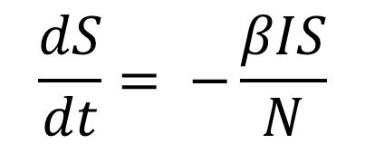
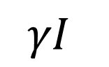
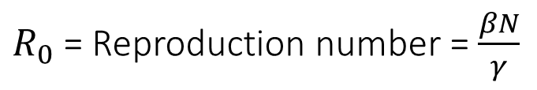

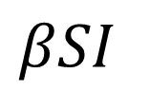
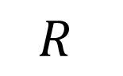
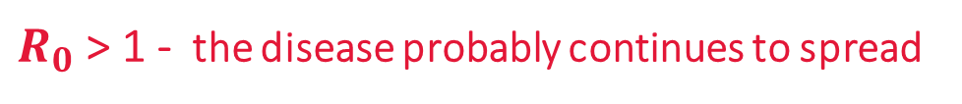
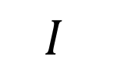
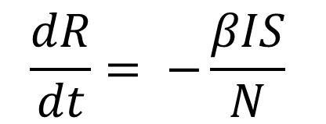
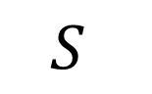
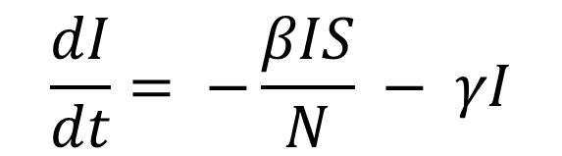
Compartmental model – SIR Model
= No. of contacts per person X P(disease transmission)
Recovery Rate
$$βSI$$
$$γI$$
Susceptible
Infectious
Recovered
$$S$$
$$I$$
$$R$$
$$\frac{dS}{dt}= −\frac{βIS}{N}$$
$$\frac{dI}{dt}= −\frac{βIS}{N} − γI$$
$$\frac{dR}{dt}= −\frac{βIS}{N}$$
$R_{0}$ = Reproduction number = $\frac{βN}{γ}$
$R_{0}$ > 1 - the disease probably continues to spread
$R_{0}$ < 1 - the disease slowly dies down
Source: https://en.wikipedia.org/wiki/Compartmental_models_in_epidemiology

Slide 8
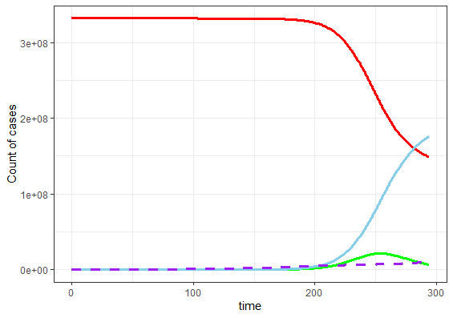
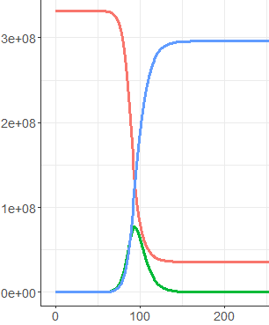
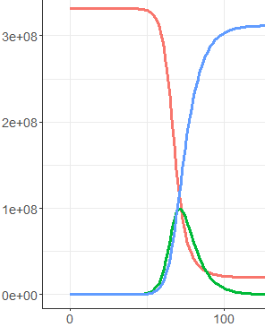



US
$R_{0}$ = 1.62
$R_{0}$ = 2.5
$R_{0}$ = 3.0
S
S
S
R
R
R
I
I
I

Slide 9
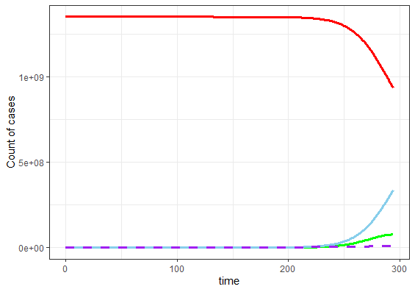
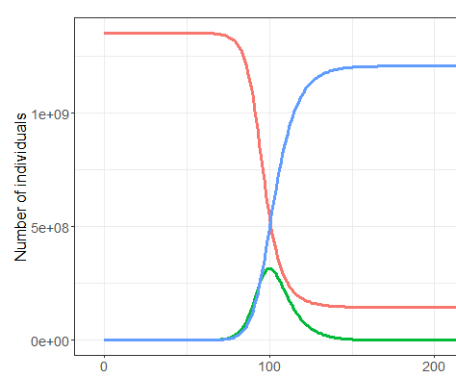
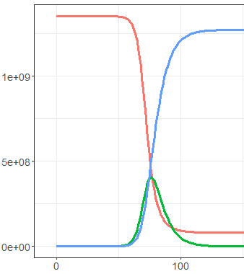

INDIA
$R_{0}$ = 1.46
$R_{0}$ = 2.5
$R_{0}$ = 3.0
S
S
S
R
R
R
I
I
I

Slide 10
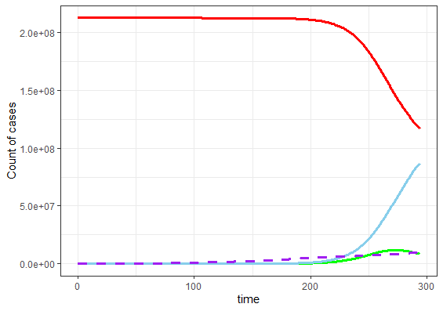
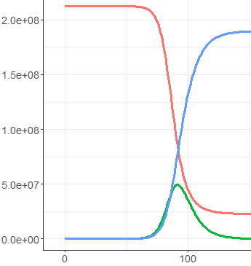
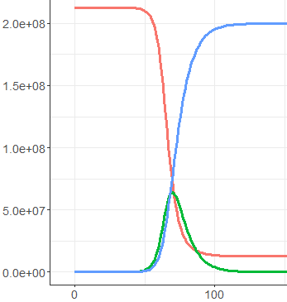
BRAZIL
$R_{0}$ = 1.46
$R_{0}$ = 2.5
$R_{0}$ = 3.0
S
S
S
R
R
R
I
I
I

Slide 11

Balanced scorecard slide 10
THANK YOU

